Slide 1
Autonomous Navigation using Q learning for Indoor Environment
Janakiraman Kirthivasan
UID – 116349086
RAMA PRASHANTH UID – 116428941

Slide 2
Contents
Introduction
Motivation
Background on Reinforcement Learning
Implementation Approach
Analysis and Results
Demonstration
Conclusion

Slide 3
Introduction
Mobile Robots Application
Commercial
Industrial
Security
Autonomous Navigation for Mobile Robots
Physical Guidance Devices
Machine Learning Strategies
Applicability of these systems
Unstructured environment
Indoor navigation

Slide 4

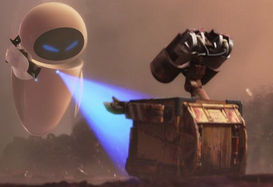
Motivation
Conventional Navigation | Cons | Dependencies
Relative Position | Accumulative error | Sensors like gyro/accelerometer/e-compass
Absolute Position | Expensive | Laser/Radio waves from beacon
Mapping | High-tech entry barriers | Image processing, Dual cam (3D image)

Slide 5
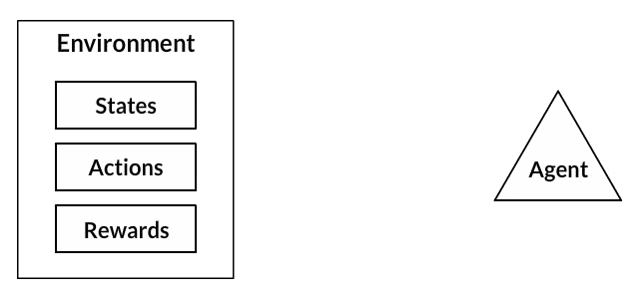
Background
Reinforcement Learning
Policy
Reward
Value function
Optimal model of environment
Model-free (trial and error)
Off-policy agent (learns different from current execution)
Markov Decision Process (R: SxA)
Temporal Difference (learning at each step)

Slide 6
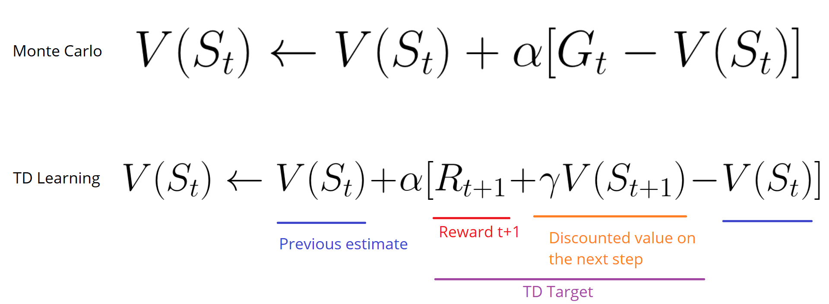
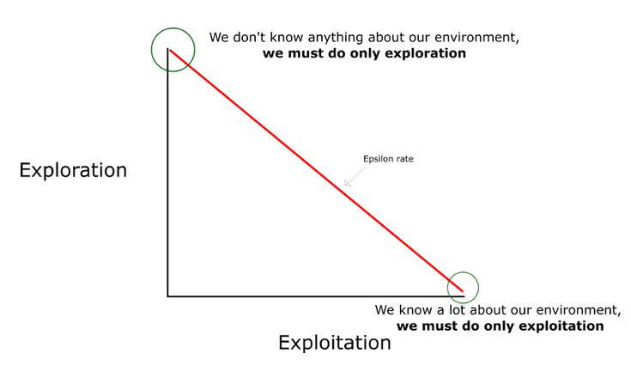

Slide 7
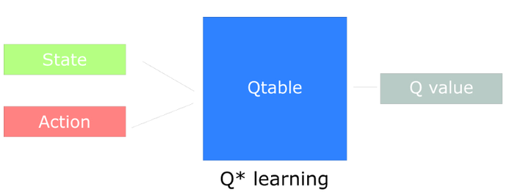
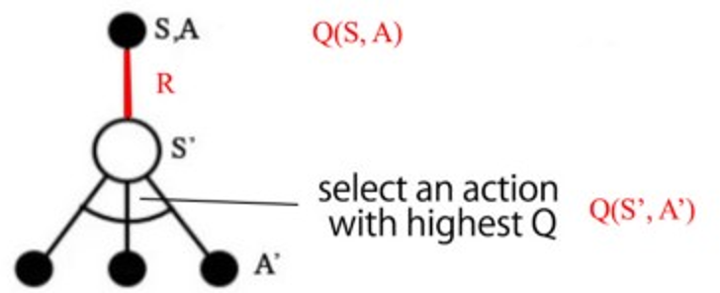
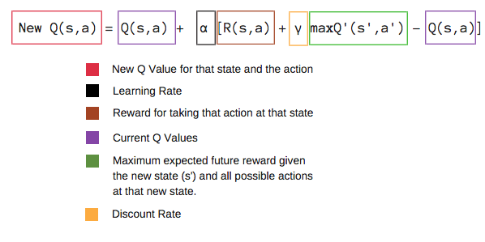
Machine Learning Method

Slide 8
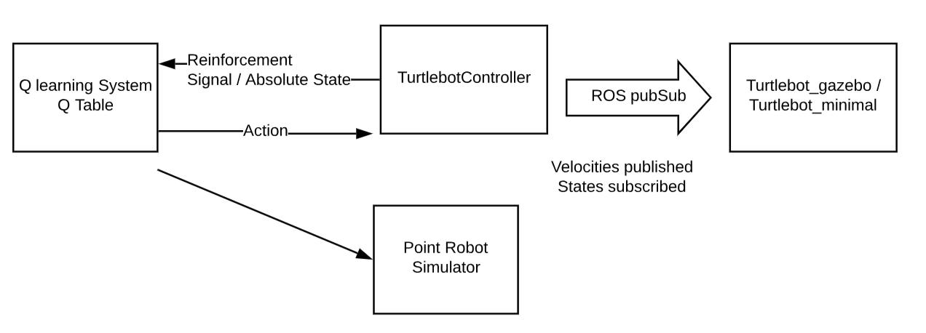
System Overview

Slide 9
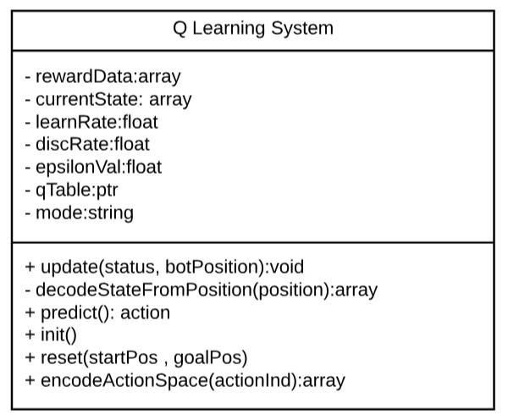
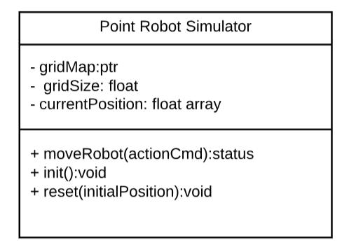
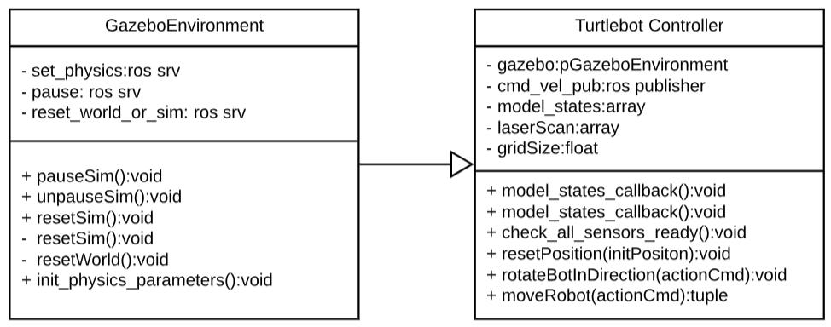
Class Level Architecture

Slide 10
Implementation
System details
Point Robot
States – grid position
Actions – Top, Down, Left and Right
Q Learning System
Each step: -1
Obstacle in path: -5
Goal Position Reached: -1000
Epsilon Greedy Policy – 0.2
Simulation
Turtlebot using Gazebo ROS
Sensory inputs: Laser, Odometry
Actuator input: Mobile Base velocity

Slide 11
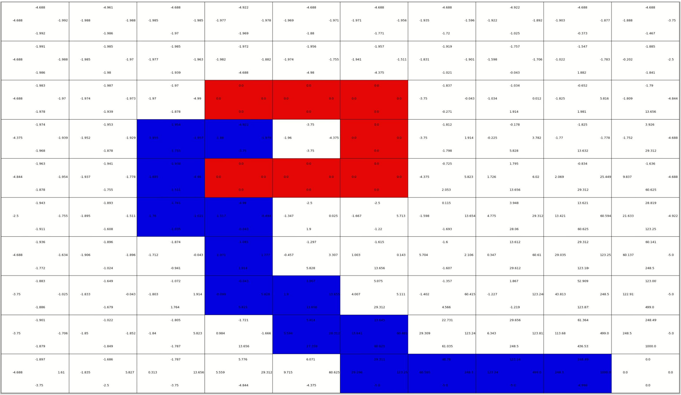
Updated Q Table

Slide 12
Demonstration

Slide 13
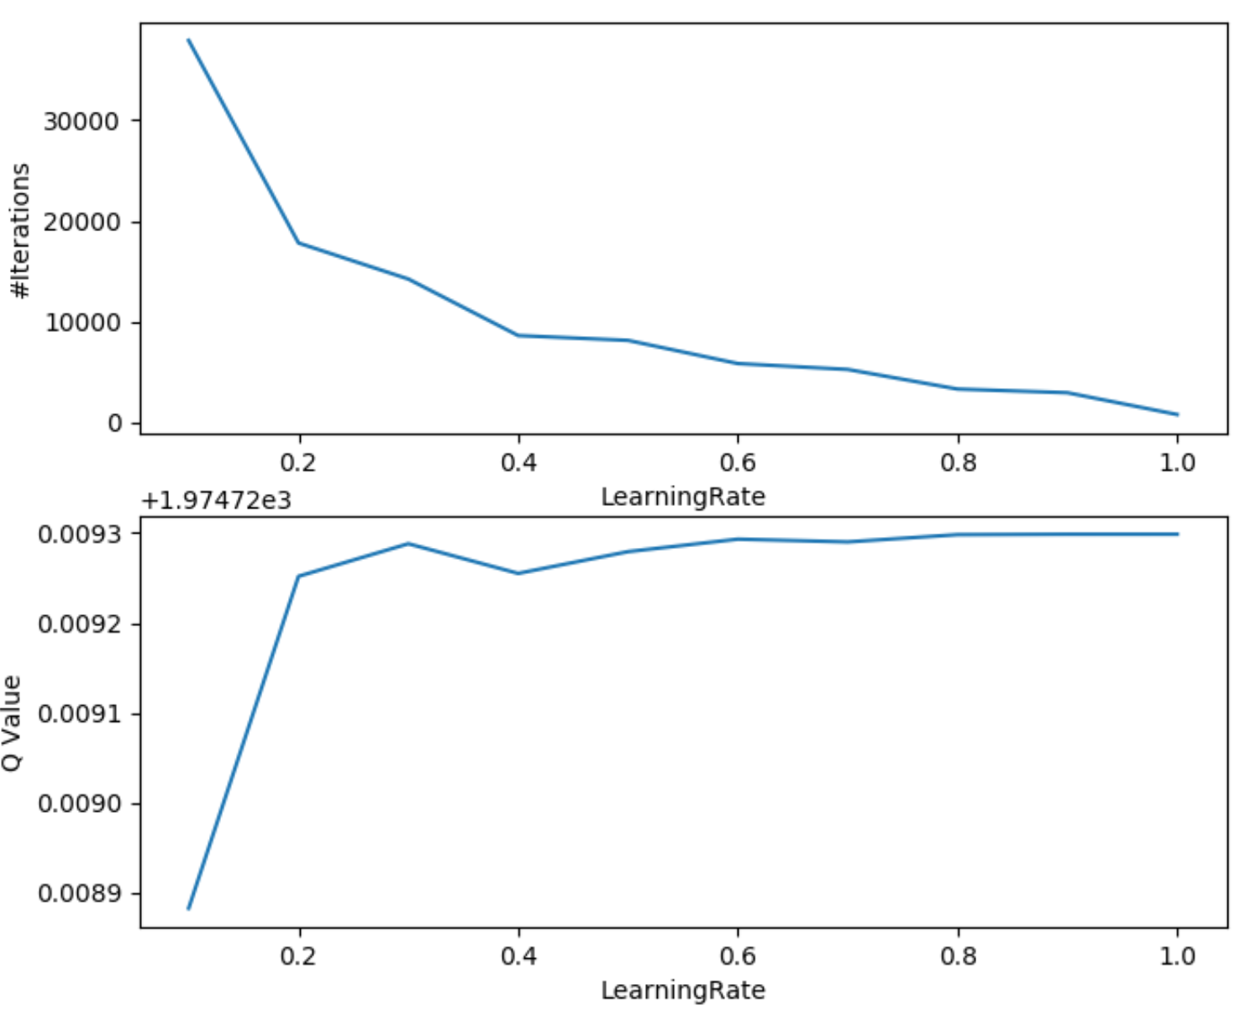
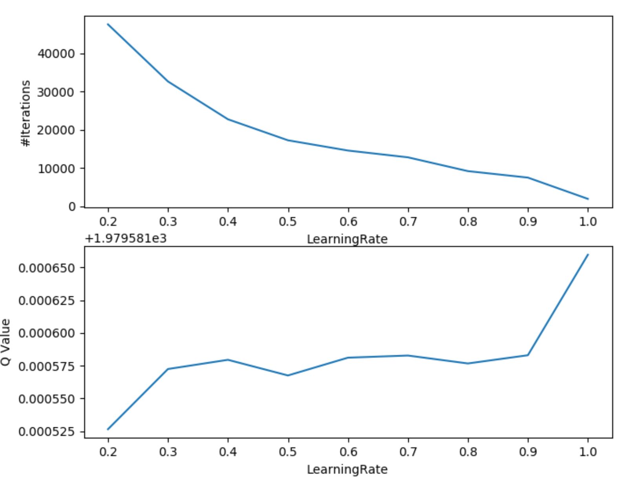
Analysis

Slide 14
References
https://ieeexplore.ieee.org/stamp/stamp.jsp?tp=&arnumber=5972477&tag=1
https://medium.freecodecamp.org/an-introduction-to-q-learning-reinforcement-learning-14ac0b4493cc
https://medium.freecodecamp.org/diving-deeper-into-reinforcement-learning-with-q-learning-c18d0db58efe
https://medium.com/@jonathan_hui/rl-dqn-deep-q-network-e207751f7ae4
https://medium.freecodecamp.org/an-introduction-to-reinforcement-learning-4339519de419
https://www.learndatasci.com/tutorials/reinforcement-q-learning-scratch-python-openai-gym/

Slide 15
To conclude…

